Slide 1

JavaScript APIs
Modern APIs that will make your apps more userfriendly

Slide 2
Agenda
History API
getUserMedia
Geolocation API
Fullscreen API
postMessage
Workers API
Instrument for processing and creating files in browser
“Link” to binary file representation in memory
Retrieve location of user’s device
Allows application to be shown in full-screen mode
Secure data exchange, sandboxing
Run scripts in background threads

Slide 3

Introduction
The HTML5 revolution has provided us some awesome JavaScript and HTML APIs. Some are APIs we knew we've needed for years, others are cutting edge mobile and desktop helpers.

Slide 4
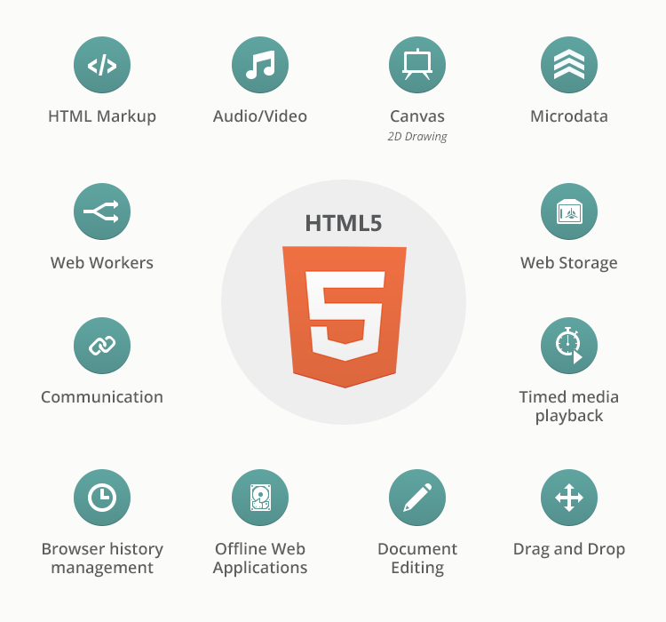

Slide 5
History API
Control address bar and application navigation
Notes:
http://html5doctor.com/history-api/

Slide 6

MARTY WE CAN CONTROL
BROWSER HISTORY

Slide 7
History API
Motivation
Proper URL in address bar
Friendly for search engines
Easy handling of Back button
Easy communication with server
Store website/application state
Hash and hashbang are not sent to the server

Slide 8
History API
window.history interface
JAVASCRIPT
window.history.state //current state object
window.history.length //history length
window.history.go(delta)//goes back/forward for delta steps
window.history.back()//same as go(-1)
window.history.forward()//same as go(1)
window.history.pushState(data, title, url)
window.history.replaceState(data, title, url)

Slide 9
History API
States. Initial
You can imagine history as line of states.
url: users
data: null
url: users/usr1
data: {
id:2,
login: ‘user1’,
role: ‘user’
}
url: users/usr2
data: {
id:5,
login: ‘user2’,
role: ‘moderator’
}
url: users/admin
data: {
id:1,
login: ‘admin’,
role: ‘admin’
}
states
timeline
-3
-2
-1
0

Slide 10
History API
States. pushState
JAVASCRIPT
var guest = {id: 0, login: null, role: 'guest'};
window.history.pushState(guest, '', 'users/guest');
url: users
data: null
url: users/usr1
data: {
id:2,
login: ‘user1’,
role: ‘user’
}
url: users/usr2
data: {
id:5,
login: ‘user2’,
role: ‘moderator’
}
url: users/admin
data: {
id:1,
login: ‘admin’,
role: ‘admin’
}
url: users/guest
data: {
id:0,
login: ‘null’,
role: ‘guest’
}
states
timeline
-4
-3
-2
-1
0

Slide 11
History API
States. go back
JAVASCRIPT
window.history.go(-2);
url: users
data: null
url: users/usr1
data: {
id:2,
login: ‘user1’,
role: ‘user’
}
url: users/usr2
data: {
id:5,
login: ‘user2’,
role: ‘moderator’
}
url: users/admin
data: {
id:1,
login: ‘admin’,
role: ‘admin’
}
url: users/guest
data: {
id:0,
login: ‘null’,
role: ‘guest’
}
states
timeline
-2
-1
0
1
2

Slide 12
History API
States. replaceState
JAVASCRIPT
window.history.replaceState({id: 5, login: 'user2', role: 'user'}, '');
url: users
data: null
url: users/usr1
data: {
id:2,
login: ‘user1’,
role: ‘user’
}
url: users/usr2
data: {
id:5,
login: ‘user2’,
role: ‘user’
}
url: users/admin
data: {
id:1,
login: ‘admin’,
role: ‘admin’
}
url: users/guest
data: {
id:0,
login: ‘null’,
role: ‘guest’
}
states
timeline
-2
-1
0
1
2

Slide 13
History API
Track state change
JAVASCRIPT
window.onpopstate = function (event) {
console.log(window.location); // http://localhost:3000/users/user2
console.log(event.state); // http://localhost:3000/users/user2
};
Don’t forger to change document.title ;)

Slide 14
History API
Routing basics
Routing – process of mapping of URL (or hash) to the function(s) that will render required result.

Slide 15
History API
Routing options
Hash based
History API based
WHEN TO PERFORM ROUTING
WHEN TO PERFORM ROUTING
DOMContetnLoaded or load event on window object
DOMContetnLoaded or load event on window object
hashchange event on window object
Click on any link for this host
popstate event on window object
Notes:
For webpages there are two possible options for routing:
Hash based – based on changes of hash part of the URL (part of the URL after #) and onhashchange event.
When to perform routing (mapping):
DOMContetnLoaded or load event on window object
hashchange event on window object
History API based – based on parsing of URL and events that might lead to its change.
When to perform routing (mapping):
DOMContetnLoaded or load event on window object
Click on any link for this host
popstate event on window object

Slide 16
History API
Track current URL
To get access to the current page URL you can use window.location of document.location objects which have list of properties which correspond to different parts of the URL. The same set of properties also available on anchor tags (<a>)
Notes:
To get access to the current page URL you can use window.location of document.location objects which have list of properties which correspond to different parts of the URL. The same set of properties also available on anchor tags (<a>)

Slide 17
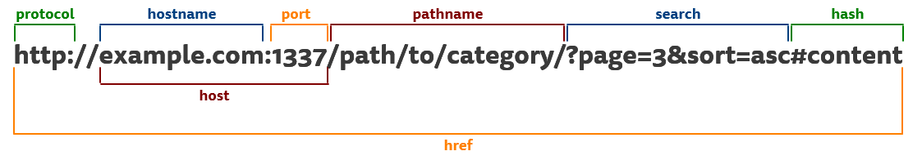
History API
Track current URL
History API based approach uses:
Parsing current page URL - window.location.pathname (window.location.pathname + window.location.search in rare cases )
Determine if link is for current web page - linkElement.host and window.location.host
Parsing currently clicked link path - linkElement.pathname
Also special methods of your application (e.g. app.navigate) may be used to programmatically decide and navigate to URL after users or server actions

Slide 18
getUserMedia
Get access to video and audio inputs from browser
Notes:
http://www.html5rocks.com/en/tutorials/getusermedia/intro/
https://developer.mozilla.org/en-US/docs/Web/API/MediaDevices/mediaDevices.getUserMedia

Slide 19
getUserMedia
Part of Media Capture and Streams – API that allow local media, including audio and video, to be requested from a platform.
Method of navigator object – asks permission to access video and audio streams.

Slide 20
getUserMedia
Request access
JAVASCRIPT
navigator.getUserMedia = navigator.getUserMedia || navigator.webkitGetUserMedia || navigator.mozGetUserMedia || navigator.msGetUserMedia; if (navigator.getUserMedia) { navigator.getUserMedia(constraints, successCb, errorCb); } else { alert('No fun with your browser'); }

Slide 21
getUserMedia
Get and use stream
JAVASCRIPT
function successCb(stream) { video.src = URL.createObjectURL(stream); //if needed for later use mediaStream = stream; } function errorCb() { alert('Error: ' + error); }
Demo: http://jsfiddle.net/mnsnroy2/

Slide 22
Geolocation API
Retrieve location of user’s device
Notes:
https://developer.mozilla.org/en-US/docs/Web/API/Geolocation

Slide 23
Geolocation API
Motivation
Allows to obtain user location
LOCATION SPECIFIC ACTION
LOCATION SPECIFIC ADS/NOTIFICATIONS
NAVIGATION
Notes:
Allows to obtain user location
Navigation
Location specific action
Location specific ads/notifications

Slide 24
Geolocation API
navigator.geolocation interface
JAVASCRIPT
navigator.geolocation.getCurrentPosition(success, error, options); navigator.geolocation.watchPosition(success, error, options); //returns id of watcher (watcherId) navigator.geolocation.clearWatch(watcherId);
Available options:
enableHighAccuracy – notifies browser to use best available position provider
timeout – how long we wait for results
maximumAge – how long we want to use cached value

Slide 25
Geolocation API
Success callback. Position object
timestamp – when Position object was acquired
coords – Coordinates object:
latitude
longitude
altitude
accuracy
altitudeAccuracy
Heading – 0 (north), 90 (east), 180 (south), 270 (west)
speed

Slide 26
Geolocation API
Error callback. PositionError object
code – error code. One of:
PositionError.PERMISSION_DENIED //(1) PositionError.POSITION_UNAVAILABLE //(2) PositionError.TIMEOUT //(3)
message – error message

Slide 27
Geolocation API
Example
JAVASCRIPT
navigator.geolocation.getCurrentPosition( function (position) { for (var coord in position.coords) { document.body.innerHTML += '<p>' + coord + ': ' + position.coords[coord] + '</p>'; } }, function (error) { alert('Error ' + error.code + '\n' + error.message); }, { enableHighAccuracy: true });

Slide 28
Geolocation API
Example. Watcher
JAVASCRIPT
var startWatcher = document.getElementById('start'); var stopWatcher =document.getElementById('stop'); startWatcher.onclick = function() { watcher = navigator.geolocation .watchPosition(successCb, errorCb, options); }; stopWatcher.onclick = function() { navigator.geolocation.clearWatch(watcher); };

Slide 29

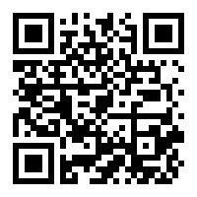
Geolocation API
Demo
http://jsfiddle.net/kv1dsdLc/embedded/result,js/

Slide 30
Fullscreen API
Allows application to be shown in full-screen mode
Notes:
https://developer.mozilla.org/en-US/docs/Web/API/Fullscreen_API
http://www.html5rocks.com/en/mobile/fullscreen/?redirect_from_locale=ru

Slide 31
Fulscreen API
Fullscreen interface
Allows to switch whole document or element to full screen mode programmatically and apply special styling.
Element / Document:
requestFullscreen()
Document only: document.exitFullscreen() document.fullscreenEnabled document.fullscreenElement document.onfullscreenchange document.onfullscreenerror
Note: this method should be called only from event handler

Slide 32
Fulscreen API
Cross-browser differences
requestFullscreen
webkitRequestFullscreen
msRequestFullscreen
mozRequestFullScreen
fullscreenElement
webkitFullscreenElement
msFullscreenElement
mozFullScreenElement
exitFullscreen
webkitExitFullscreen
msExitFullscreen
mozCancelFullScreen
fullscreenEnabled
webkitFullscreenEnabled
msFullscreenEnabled
mozFullScreenEnabled

Slide 33
Fulscreen API
Cross-browser differences
onfullscreenchange
onwebkitfullscreenchange
onmsfullscreenchange
onmozfullscreenchange
onfullscreenerror
onwebkitfullscreenerror
onmsfullscreenerror
onmozfullscreenerror

Slide 34
Fullscreen API
Styles
Element on which request fullscreen was called:
:-webkit-full-screen
:-moz-full-screen
:-ms-fullscreen
:full-screen
:fullscreen
Backdrop:
::-ms-backdrop
::backdrop
You can have different presentation and functionality for normal and fullscreen states of same element by styling nested elements.

Slide 35

Fullscreen API
Demo
Check Fullscreen_example in materials folder

Slide 36
postMessage
Secure data exchange
Notes:
http://www.html5rocks.com/en/tutorials/security/sandboxed-iframes/

Slide 37
postMessage & cross-origin messaging
Motivation
Same Origin policy prevents communications between different domains:
- Ajax requests
- Access to content of iframes etc.
HTML5 Web Messaging provides the ability to communicate with another origins in 3 simple steps.

Slide 38
postMessage & cross-origin messaging
Steps
1
Get Window object of another document
2
Send data with postMessage method
3
Receive and process message
PostMessage
onmessage
Document A
Document B
PostMessage
onmessage

Slide 39
postMessage & cross-origin messaging
STEP 1. GET WINDOW OBJECT
JAVASCRIPT
//Document A
var docB = document.querySelector('iframe').contentWindow; // or //var docB = window.open(...); docB.postMessage('ping', 'documentB.com');

Slide 40
STEP 2. GET WINDOW OBJECT
JAVASCRIPT
//Document B
window.addEventListener('message', function(event) { if(event.origin !== 'documentA.com') { return; } document.querySelector('body').innerHTML = event.data; event.source.postMessage(event.data, event.origin);
}, false);

Slide 41
STEP 2. SECURITY
Do not use '*' as url in postMessage when you deal with private data.
For security reasons always check event.origin against whitelisted domains to ignore messages from malicious sites.
Check event.data type and content before processing it.

Slide 42
Workers API
Run scripts in background threads

Slide 43
Worker API
Motivation
JavaScript has single threated nature.
All asynchronous callbacks are added to the end of execution queue.
If some block of code runs too long user will feel that browser hangs out.

Slide 44
Worker API
Problem example
JAVASCRIPT
function heavyComputingFuntion(i) { //e.g. MC simulations here }
var m = []; for (var i = 0; i < 1000000; i++) { m[i] = heavyComputingFuntion(i); }

Slide 45
Worker API
Simple solution
JAVASCRIPT
function makeSimulations(offset, cb) { //sorter loop. e.g. 50-100 iterations if(finishCondition) { cb(m); } else { setTimeout(makeSimulations, 1, newOffset, cb); // or setImmediate(makeSimulations, newOffset, cb) // for new browsers } }

Slide 46
Worker API
Worker solution. Initial document
JAVASCRIPT
var mcWorker = new Worker('MCWorker.js'); mcWorker.postMessage(data); mcWorker.onmessage = function(event) { cb(event.data); };
Another Worker methods and properties:
postMessage() – immediately terminates worker.
onmessage – event handle. Called when we have uncaught errors in worker.

Slide 47
Worker API
Worker solution. MCWorker.js
JAVASCRIPT
function heavyComputingFuntion(i) { //MC simulations here }
onmessage = function(event) { var m = []; for (var i = 0; i < event.data; i++) { m[i] = heavyComputingFuntion(i); }
postMessage(m); };

Slide 48
Summary
This is only small part of all browser possibilities
SUCCESS
This list is really huge!
It evolves very often, so don’t forget to study new possibilities.
EXPERIMENT AND SHARE YOUR RESULTS!
Notes:
This list is really huge
https://developer.mozilla.org/en-US/docs/Web/API

Slide 49
Any Question ???
WHAT
WHY
WHERE
WHEN
WHO
HOW

Slide 50
THANKS FOR WATCH !!!

